Slide 1
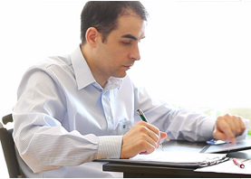
Organized Ollie
Name Ollie
Age 17 - 23
Full/Part Time Full Time
Behaviours
Time Management
Motivations
Success
What help do I need?
Communicating
Keeping track of teammates
App expectations
Group and personal timetable management system, ability to communicate
I want this app to…
Help me communicate with team members, aid my already stellar organization
I come across as…
Organized
Introverted (Fails to communicate)
Controlling
low
high
Stress Management
low
high
Setting goals and Objectives
“Where are my team memers? Why is your work not done?”
low
high
Focus
Organized Ollie is a student who excels at personal management skills. However, they struggle to keep track of and help organize their team members. They lose track of team members work, and often have to finish other people’s work at the last minute.
Organized Ollies have the ability to complete work to a lower standard, but compensate for this with excellent organisation. With access to a readily-available, solution that allows them to track their team members work. Which allows them to apply their excellent skills of organization to the rest of the group.
low
high
Ccommunicating
low
high
Ability to complete work
low
high

